Slide 1









Activity 2: Create your own business model
KEY
PARTNERS
KEY
ACTIVITIES
VALUE
PROPOSITIONS
CUSTOMER
RELATIONSHIPS
CUSTOMER
SEGMENTS
KEY
RESOURCES
CHANNELS
COST STRUCTURE
REVENUE STREAMS

Slide 2
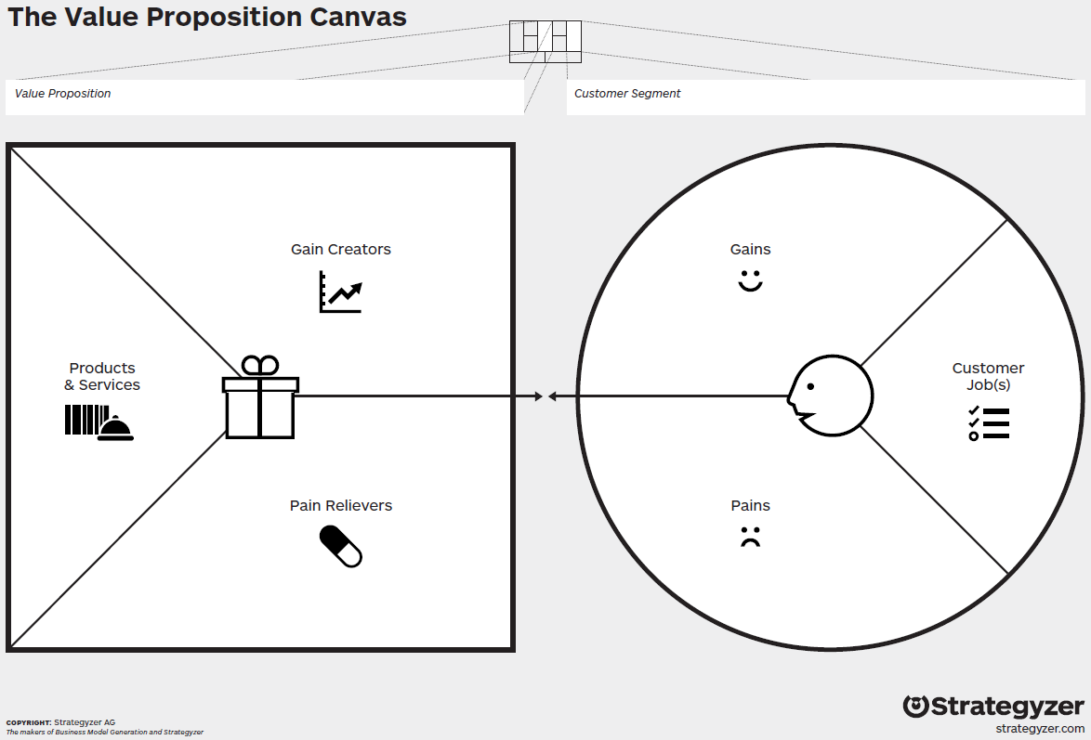
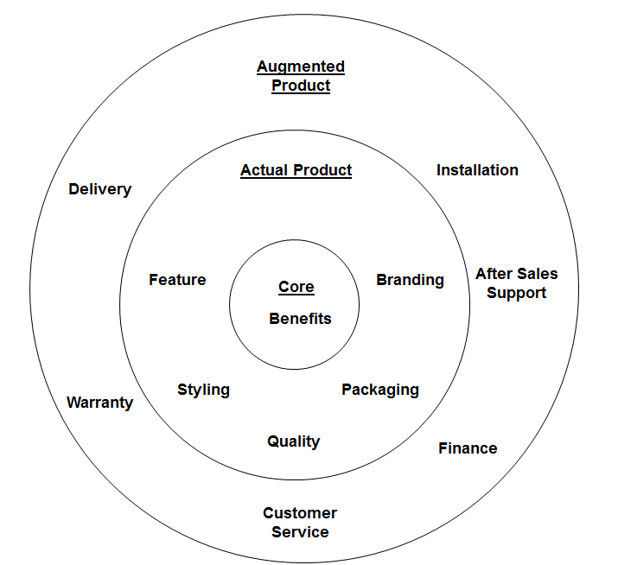
Notes:
http://www.youtube.com/watch?v=aN36EcTE54Q

Slide 3
Value Proposition for …………………
For senior management teams in secondary and independent schools
Who wish to continually improve the overall performance rating of their school
Our behaviour management system
Provides them with up-to-the-minute data on pupil behaviour and attendance allowing them to be proactive in their planning able to communicate and provide constant feedback and support to all staff ensuring that all processes, procedures and policies are effective, up-to-date and consistently applied and
Unlike our competitors our system is easy to use, fully customisable, fast and paperless
For
Our
Provides
Unlike
Notes:
The core capabilities of this system
Multiple types of data (e.g. behavioural indicators, attendance figures) can be linked (tagged) to a single entity, i.e. the pupil.
A simple user interface coupled with the innovative tagging allows fully customisable searches to be set-up and run very quickly in real time.
Multiple agencies can update, track and analyse individual pupils in real time as well as data mining across groups of pupils in order to identify, analyse and diagnose trends.
This allows planning on both a strategic as well as an operational level including the ability to make recommendations very quickly.

Slide 4
Benchmarking you and your competitors against what the customer values
Business name | Dimensions of value (customer’s acceptance criteria – size, price, etc.)
Specscart
Direct Specs
Jones and Co.
Specsavers
Source of competitive advantage:
How protected:

Slide 5
Activity 4: Clarify your key assumptions and how validated / will validate (Business Model / Value Proposition)
No. | Question | Fact (with evidence) | Assumption
1.
2.
3.
4.
5.

Slide 6
PEST
Political | Economic
Social (& Cultural) | Technological
Summary of your analysis & Key Issues

Slide 7
Porter’s 5 Forces on …………………
Threat of New Entrants
Force = Weak / Medium / Strong
Supplier Bargaining Power
Force = Weak / Medium / Strong
Buyer Bargaining Power
Force = Weak / Medium / Strong
Existing Competitive Rivalry
Threat of Substitutes
Force = Weak / Medium / Strong
Summary of your analysis & Key Issues
Force = Weak / Medium / Strong

Slide 8
SWOT
Internal
External
→ Strengths → | ← Opportunities←
↑ Weaknesses↑ | ↑Threats↑
Positive
Negative
Summary of your analysis & Key Issues

Slide 9
Enabling your CSFs
9
Competences
What can your resources do and at what level?
Threshold competence – necessary
Core competence – ability to outperform the competition
Bases of competences
Cost Efficiency
Value Added
Managing linkages
Robustness
Resources
Analysing Resources and Capabilities
Resources that an organisation owns or can access to support its strategies
Can you identify any unique resources
i.e. those that create competitive advantage e.g. patent, location etc.
Resource Audit
Notes:
Identify the activities of an organisation and then analyse them for competence.
Primarily trying to identify strengths
e.g. a unique resource or core competence
But don’t forget potential weaknesses
e.g. resource gaps, poor competencies etc.
Value Chain Analysis
Describes the separate activities
Analyse activities in terms of efficiency, effectiveness and coordination.

Slide 10
Firm Infrastructure
Service
Support Activities
Marketing and Sales
Resource Procurement
Competitive Advantage
& Increased Profit Margin
Inbound Logistics
Operations
Outbound Logistics
Technology Development
HR Management
Primary Activities

